Slide 1
Movie Trends from 1972 to 2016
Eric Penrose, Lance Weston, and Reneise White

Slide 2
Questions
How many movies in horror, romance, and sci-fi genres are released each year?
How are the box office totals changing for these genres over the years?
Is there any difference in box office totals of movies that are released during their “peak season” vs. being released any other time of the year?

Slide 3
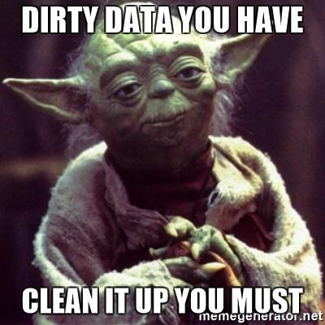
Finding and Cleaning Data

Slide 4

Finding the Data
Uncleaned starter csv url:
(https://www.imdb.com/list/ls057823854/)
Omdbapi url:
http://www.omdbapi.com/?i={ID}&apikey={key}

Slide 5
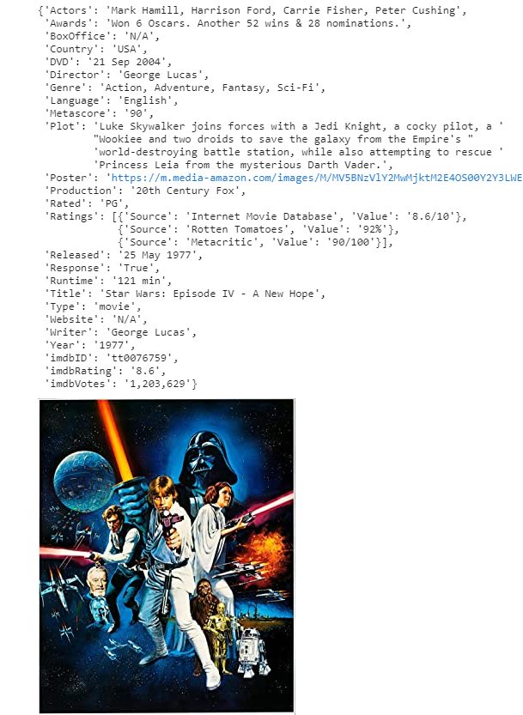
Using VSCode and Jupyter Notebook To Clean The Data
Created the formatted code in a .py file and moved it into a .ipynb file.
Issues that arose while cleaning data
Awards data was listed as a sentence in multiple formats and made it hard to clean up.
The list of dictionaries containing the ratings was silly.
Lots of NaN values after the API pull.
Main insights:
Pull the CSV once and do the clean up in a separate file so that you didn’t have to pull it again.
Then save the cleaned data frame under a different name so we always had the raw data.
DataFrames lose certain data types when exported as a csv.

Slide 6


Example of list of dictionaries containing the ratings
Example of basic formatting

Slide 7
Data Analysis & Visualization
Using Matplotlib

Slide 8
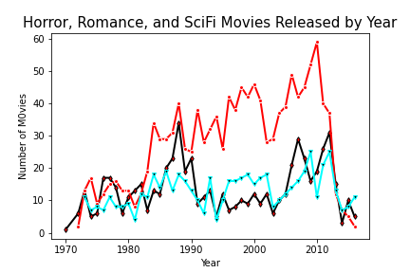
Legend
___ Romance
___Horror
___Sci-Fi
Notes:
Additional slide for question answering and plots.

Slide 9
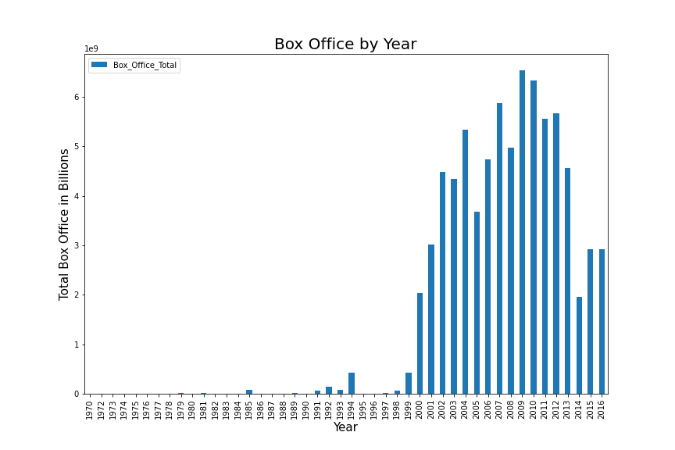
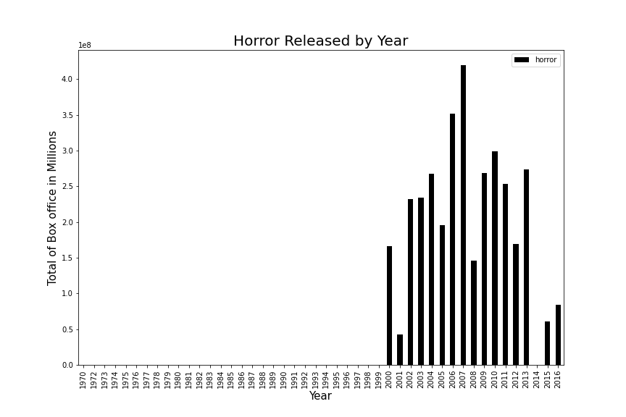
Bias of box office reporting
Notes:
3 slides for 3 questions. 1 minute per slide max.

Slide 10
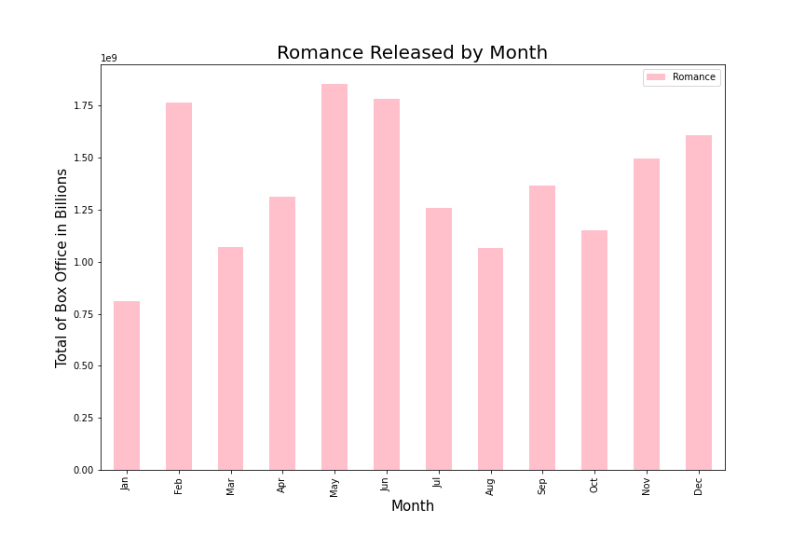

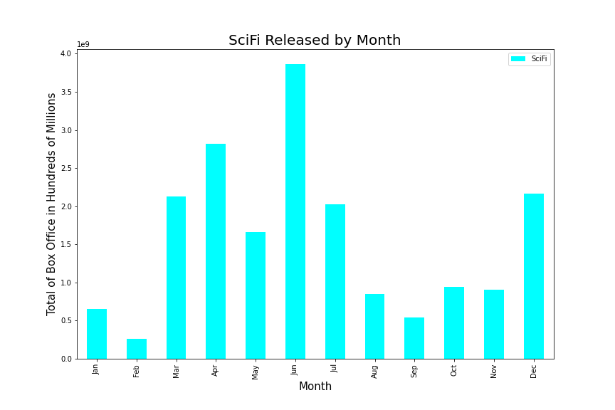
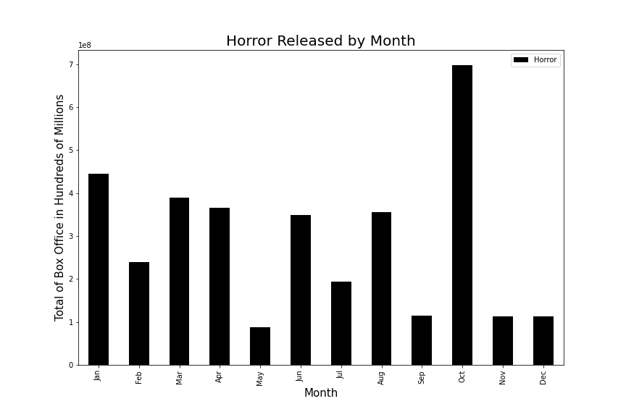
Movies Released By Month

Slide 11
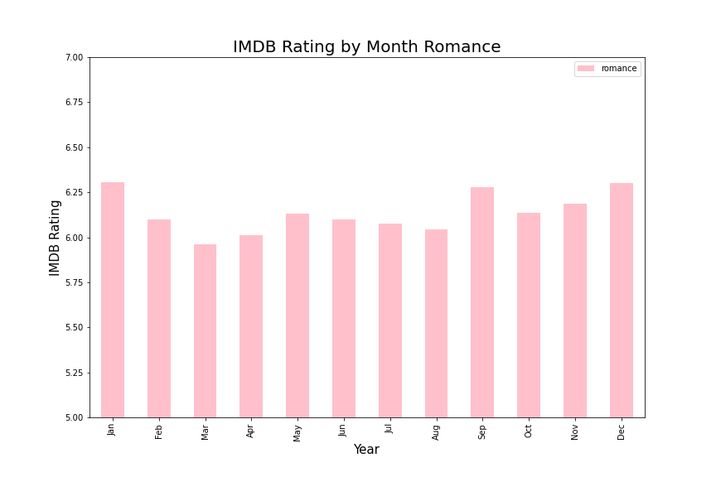
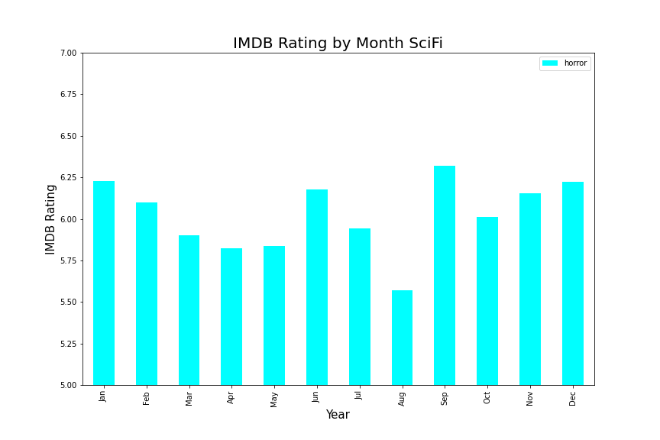
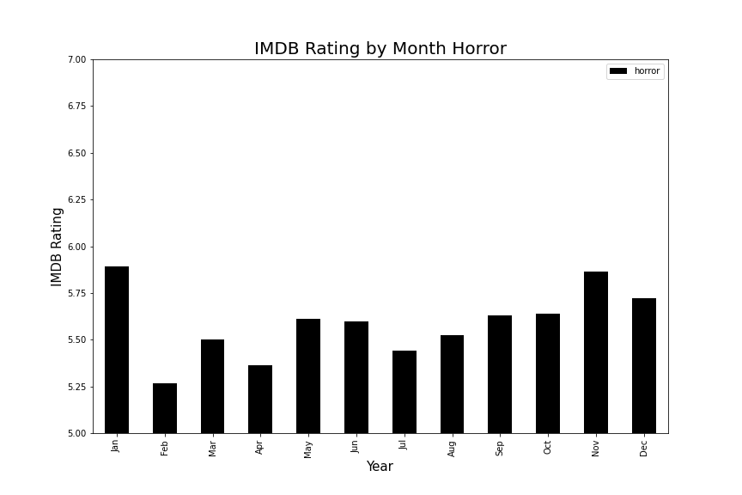
Movies Rated By Month Released

Slide 12
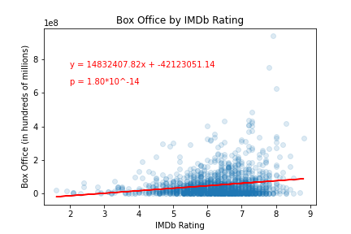
Do higher rated movies make more money?
Notes:
Yes...yes they do.
P Value = 0.00000000000018

Slide 13
Discussion, Conclusions, and Parting Thoughts
Notes:
Max 2 minutes so we can get to questions etc.

Slide 14
Overall, this was a very interesting project and if we had extra time we would have explored the following:
In particular do movies created by the same directors in different genres make more revenue compared to other directors
We also would have explored movie ratings given by Metacritic, Rotten Tomatoes, etc.
Would have to find a way to do this while accounting for bias of these ratings
Correlate movies in the same series but different franchises.
Consider how to eliminate effect of multiple movies
Does the number of genres that a movie is classified under, affect its rating or its box office total?

Slide 15
Questions
Thanks for listening!

Slide 16
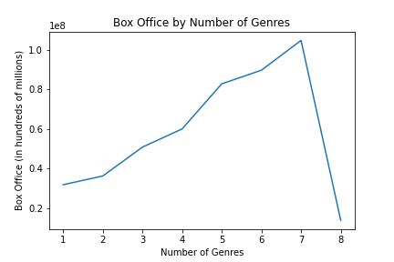
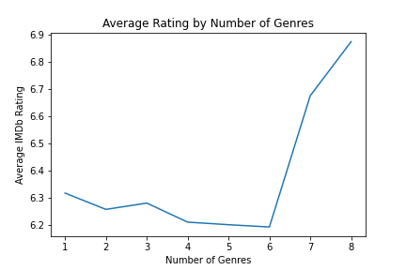
Does frivolous genre..ing increase Box Office?
Does it make for a higher rated movie?
Strong inverse correlation between Average Box Office and Average Rating based on Number of Genres.
Notes:
I know if I ever make a movie, i’ll make dang sure it fits into 7 Genres.

Slide 17
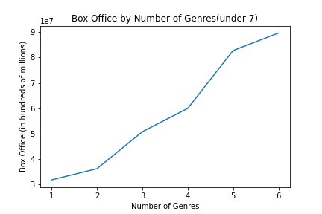
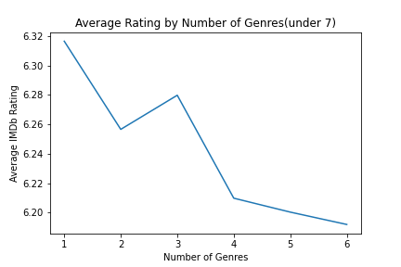
After removing bins with only a handful of niche movies (ones with 7+ genres)
Is it right to chop off the last couple bins in this case? Who can say..
The headline here is that trends appear clearer and inverse correlation between the two remains whether or not data removal is appropriate.
Notes:
Trends are now more clear

